Slide 1
BS IT • INTERACTIVE WORKSHOP
Build a LinkedIn Profile That Gets Noticed
Write with clarity.
Show evidence.
Connect professionally.
Based on Higherin’s “8 Steps to Create the Ultimate LinkedIn Profile” (updated 9 Sept 2026)
BS IT • Professional Communication
1

Slide 2
LINKEDIN PROFILE WRITING
Why LinkedIn matters for BS IT
Present your skills and achievements to potential employers.
Discover internships, graduate roles, and industry contacts.
Showcase software, data, cybersecurity, and web projects.
Develop a credible professional identity before graduation.
Think of your profile as a professional introduction—not a list of adjectives.
BS IT • Professional Communication
3

Slide 3
LINKEDIN PROFILE WRITING
The article’s eight-step roadmap
1. Create an account • 2. Add a professional photo
3. Design a cover image • 4. Write a headline
5. Complete the About section
6. Add experience and education
7. List relevant skills • 8. Request recommendations
BS IT • Professional Communication
4

Slide 4

LINKEDIN PROFILE WRITING
Steps 1–3 | First impressions
Use your real professional name and accurate details.
Choose a clear, well-lit headshot with a neutral background.
Select a banner that reflects your technical interests.
Keep the visual identity professional and consistent.
Article guidance: profile photo, cover photo, and account setup.
BS IT • Professional Communication
5

Slide 5
LINKEDIN PROFILE WRITING
Step 4 | Write a stronger headline
LESS EFFECTIVE
MORE EFFECTIVE
Student | Looking for opportunities | Hardworking
BS IT Student | Python & SQL | Aspiring Data Analyst
BS IT • Professional Communication
6

Slide 6
LINKEDIN PROFILE WRITING
Headline writing formula
WHO YOU ARE + TECHNICAL FOCUS + CAREER DIRECTION
Example: BS IT Student | React & JavaScript | Front-End Developer
Example: Computer Science Undergraduate | Python | AI/ML Enthusiast
Choose only skills you can explain or demonstrate.
ACTIVITY 1: Write a 12–18-word headline for a specific internship.
BS IT • Professional Communication
7

Slide 7
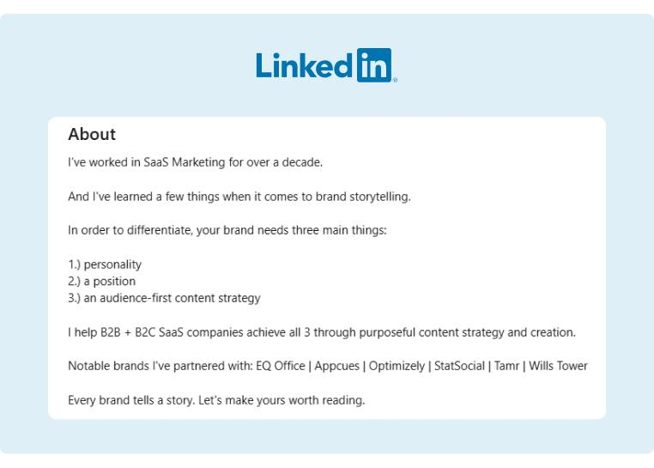
LINKEDIN PROFILE WRITING
Step 5 | Structure the About section
Opening: academic identity and specialization.
Middle: technical skills and one credible project example.
Evidence: describe your contribution and the outcome.
Closing: career interests and professional goals.
Write in the first person. Use specific, readable language.
BS IT • Professional Communication
8

Slide 8
LINKEDIN PROFILE WRITING
About section | Before and after
VAGUE
SPECIFIC & EVIDENCE-BASED
I am a passionate, hardworking and motivated student. I know many technologies and want a good job.
I am a BS IT student interested in web development. I built a responsive event-registration website using HTML, CSS and JavaScript. I enjoy translating user needs into accessible interfaces and am seeking a front-end internship.
BS IT • Professional Communication
9

Slide 9
LINKEDIN PROFILE WRITING
Linguistic lens | Make your writing credible
Use precise nouns: “inventory dashboard” rather than “project.”
Prefer action verbs: designed, tested, implemented, analyzed.
Support claims with observable work or verified results.
Maintain an authentic, confident—not exaggerated—tone.
“Expert in everything” is less persuasive than one demonstrable skill.
BS IT • Professional Communication
10

Slide 10
LINKEDIN PROFILE WRITING
Step 6 | Education and experience
Add your university, degree, and expected graduation year.
Include internships, volunteer roles, and relevant responsibilities.
Write 2–3 concise achievement-focused points per role.
Show the technical task, your contribution, and the result.
If you lack work experience, use coursework and projects honestly.
BS IT • Professional Communication
11

Slide 11
LINKEDIN PROFILE WRITING
Project description | Weak vs strong
TASK LIST
ACTION + TOOL + RESULT
Worked on a database project. Responsible for coding and other tasks.
Developed a library-management database using MySQL; designed relational tables, wrote SQL queries, and tested book-issue and return workflows.
BS IT • Professional Communication
12

Slide 12
LINKEDIN PROFILE WRITING
Step 7 | Select relevant skills
Programming: Python, JavaScript, Java, C++ (as applicable).
Tools: Git, GitHub, VS Code, MySQL, Power BI.
Methods: debugging, testing, data analysis, UI design.
Communication: teamwork, documentation, problem-solving.
Only list skills you genuinely possess; avoid keyword stuffing.
BS IT • Professional Communication
13

Slide 13
LINKEDIN PROFILE WRITING
Step 8 | Request recommendations
Approach a lecturer, supervisor, or project collaborator.
Mention the course, project, or work you completed together.
Request a specific and truthful recommendation politely.
Thank the person and respect their decision.
BS IT • Professional Communication
14

Slide 14
LINKEDIN PROFILE WRITING
Professional networking message
TOO ABRUPT
COURTEOUS & PURPOSEFUL
Hi, connect with me. I need an internship ASAP.
Dear Ms. Ahmed, I am a BS IT student exploring cybersecurity internships. I appreciated your recent post on network security and would be pleased to connect and learn from your work.
BS IT • Professional Communication
15

Slide 15
LINKEDIN PROFILE WRITING
ACTIVITY 2 | Profile editing challenge
Rewrite this About section in 70–90 words:
“I am very talented. I know computers and have done lots of projects. I want a great career.”
Include: degree • two relevant skills • one specific project • a realistic career goal.
BS IT • Professional Communication
16

Slide 16
LINKEDIN PROFILE WRITING
ACTIVITY 3 | Peer review
Exchange draft headlines and About sections.
01 Can you identify the intended IT role in five seconds?
02 Is every technical claim supported by evidence?
03 Does the text sound authentic and professional?
04 Is the writing concise, correct, and reader-focused?
BS IT • Professional Communication
17

Slide 17
LINKEDIN PROFILE WRITING
Final profile checklist
Clear photograph and relevant banner
Focused headline and first-person About section
Accurate education, experience, and projects
Relevant, verifiable technical and interpersonal skills
Professional tone, proofreading, and respectful networking
BS IT • Professional Communication
18

Slide 18
LINKEDIN PROFILE WRITING
Your exit ticket | Build your first draft
1 Write your headline.
2 Draft a 90-word About section.
3 Describe one project in two achievement-focused bullets.
4 Request feedback from a partner.
Submit the text draft; publishing it online is optional.
BS IT • Professional Communication
19

Slide 19
LINKEDIN PROFILE WRITING
Source and teaching notes
PRIMARY SOURCE
Higherin, “8 Steps to Create the Ultimate LinkedIn Profile” (updated 9 September 2026).
https://higherin.com/careers-advice/working-life/create-ultimate-linkedin-profile
The eight-step sequence follows the source article. IT-specific examples, writing formulas, linguistic analysis, and classroom activities are original teaching adaptations.
BS IT • Professional Communication
20

